Slide 1


Book Ordering Portal
Created By
Vivek Sanger(AF0351060) and Anjali Rai(AF035S1083)
Batch code – ANPC6984

Slide 2
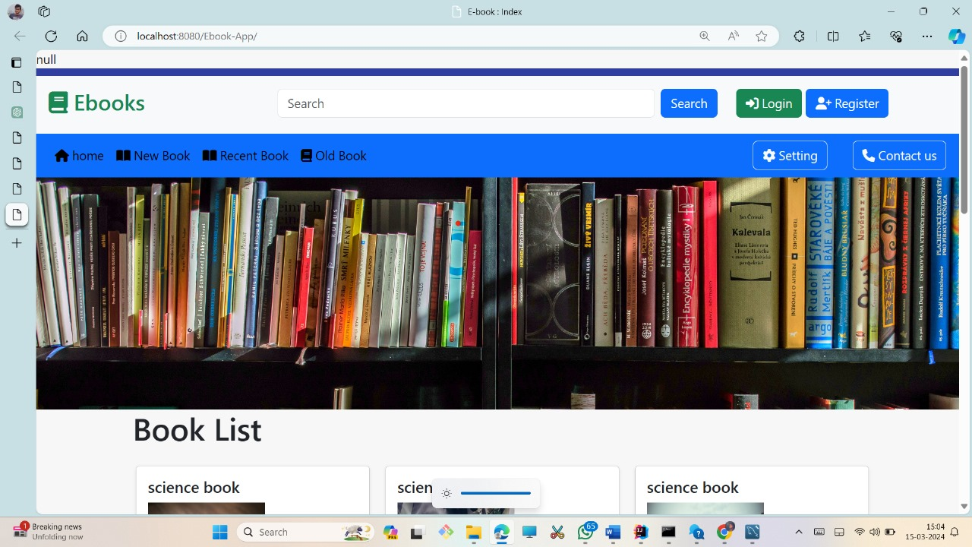
Home Page

Slide 3
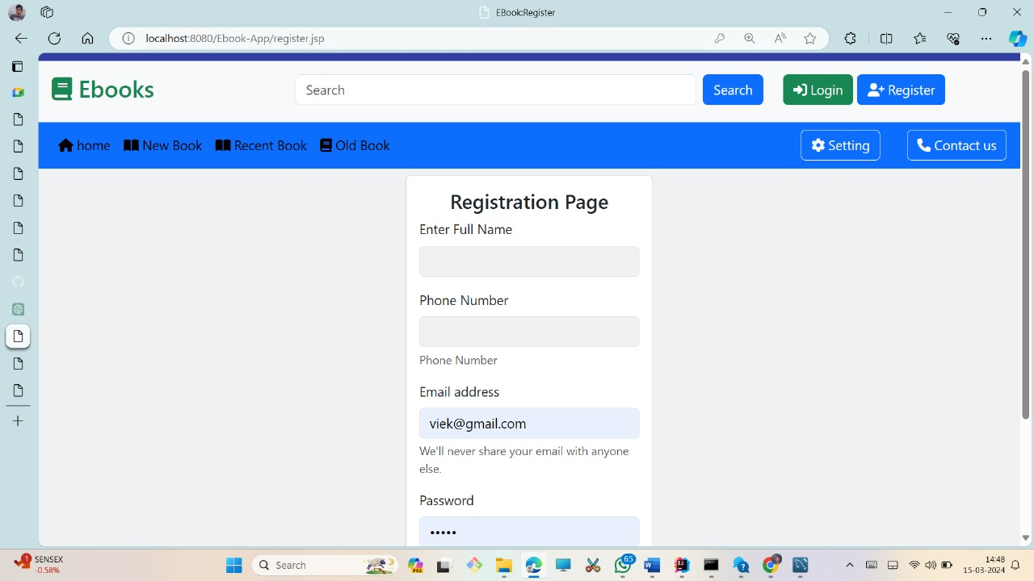
Registration Page

Slide 4
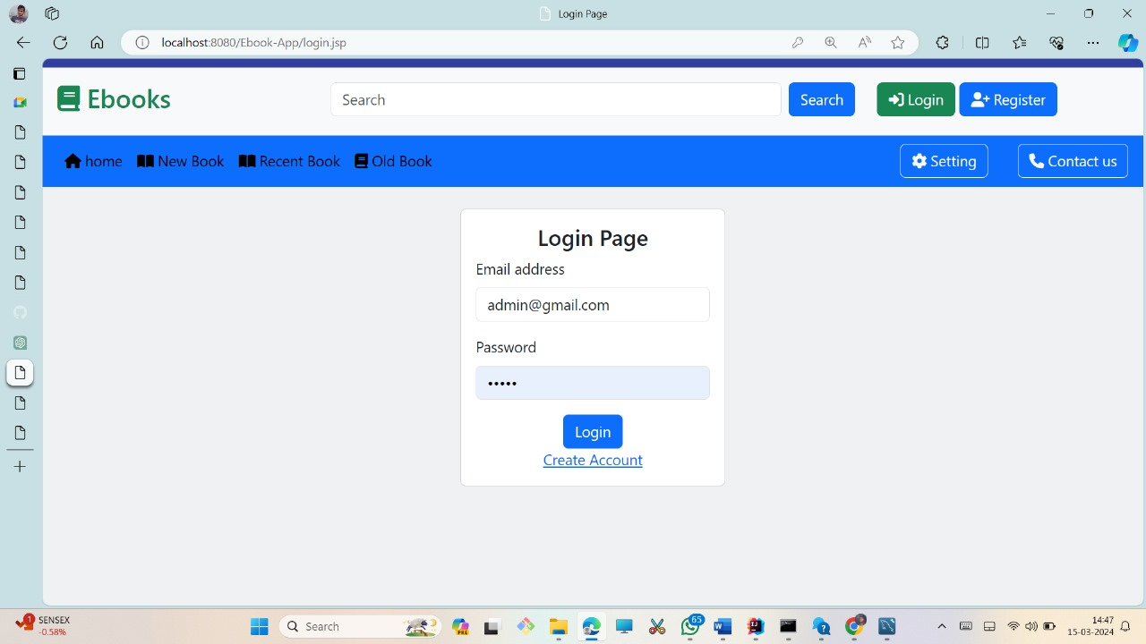
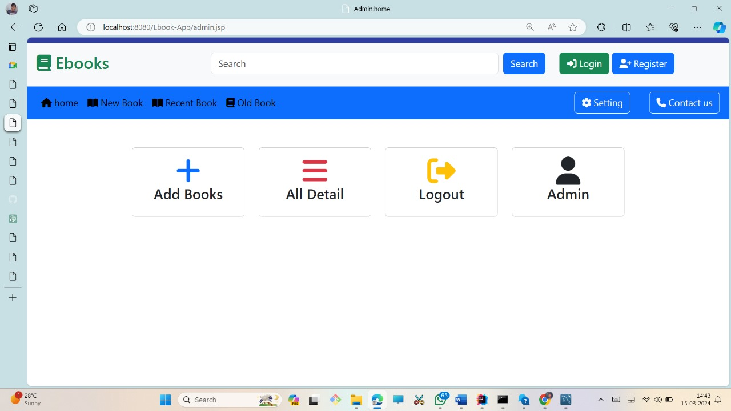
Login for admin

Slide 5
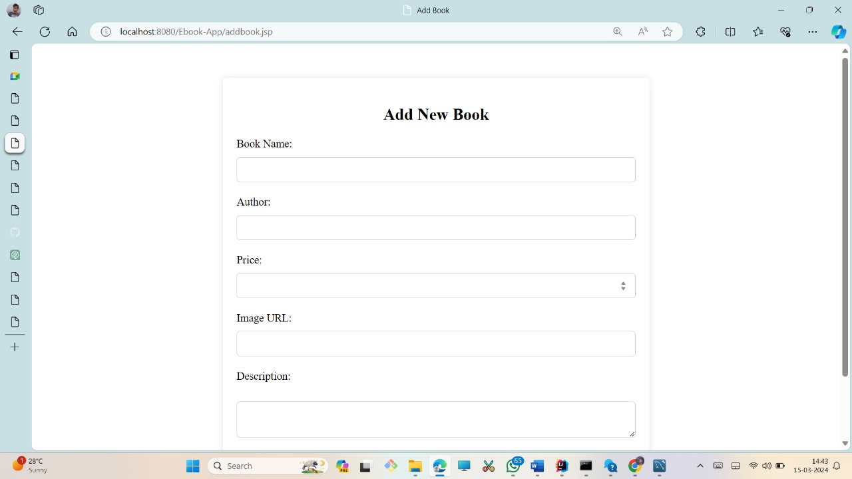
Add New Book

Slide 6

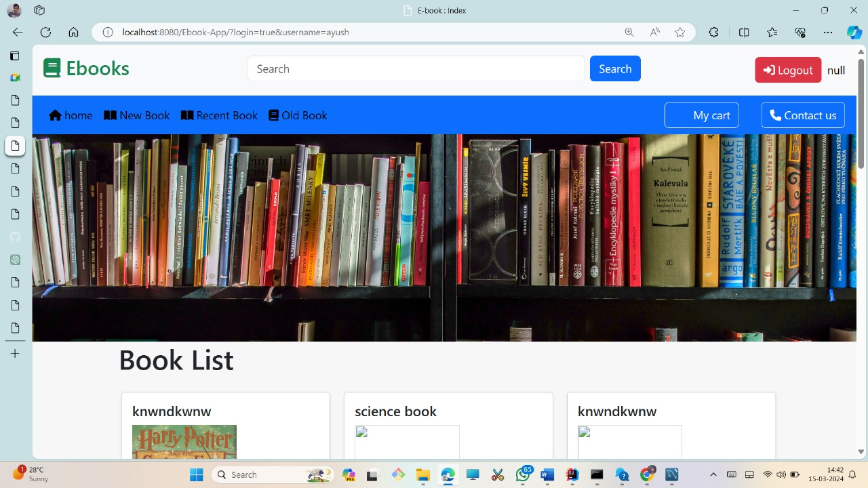

User Login

Slide 7
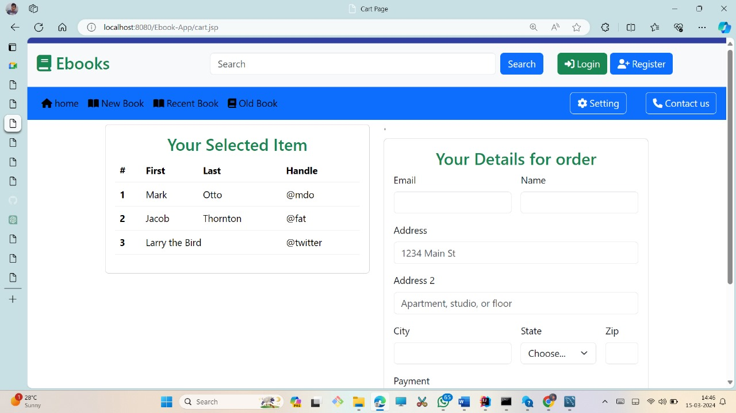

Cart

Slide 8
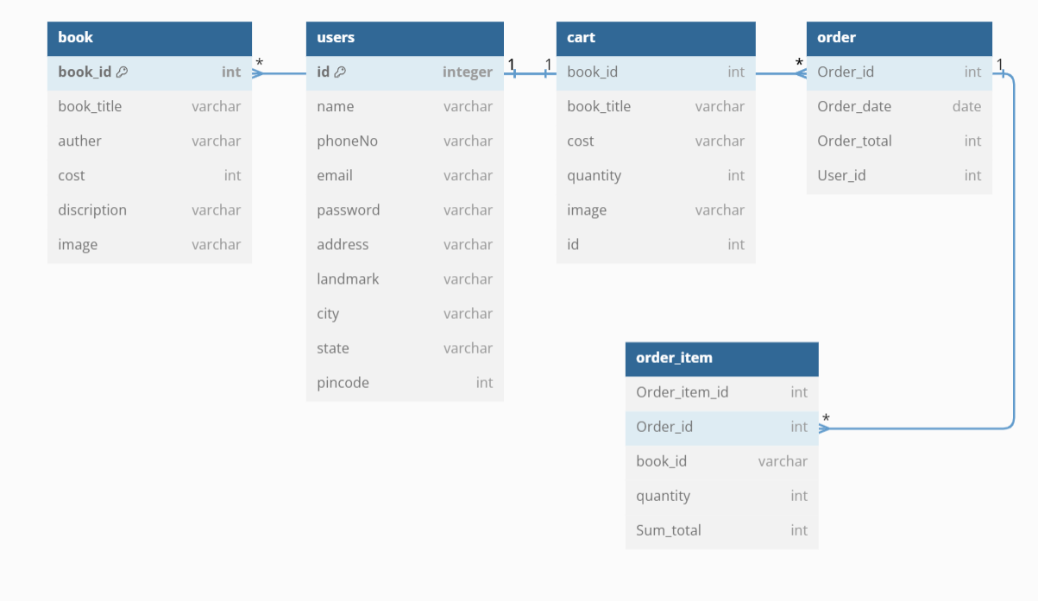
Database design

